Slide 1
Analysis of Algorithms
Analyzing control structures
    Sequencing
    For loops
    While and repeat loops
    Recursive calls
Finding and using a barometer
Average case analysis
  Probabilistic Analysis and Randomized Algorithms
Amortized analysis

Slide 2
Control structures: sequences
P is an algorithm that consists of two fragments, P1 and P2
P1 takes time t1 and P2 takes times t2
The sequencing rule asserts P takes time
t=t1+t2  Θ(max(t1,t2)).
P
{
P1;
P2;
}

Slide 3
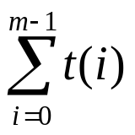
For loops
Case 1: P(i) takes time t independent of i and m>0, then the loop takes time O(mt) if m>0.
Case 2: P(i) takes time t(i), the loop takes time
for (i=0; i<m; i++) {
P(i);
}

Slide 4
Example: analyzing the following nests
for (i=0; i<n; i++) {
for (j=0; j<n; j++)
constant work
}
for (i=1; i<n; i++) {
for (j=0; j<i; j++)
constant work
}
for (i=1; i<n; i++) {
for (j=0; j<i*i; j++)
constant work
}
for (i=1; i<n; i++) {
for (j=0; j<i; j++)
constant work
for (k=0; k<i*i; k++)
constant work
}

Slide 5
Example
Fn_2 = 0;
Fn = Fn_1 = 1;
for (i=2; i<=n ; i++) {
Fn = Fn_1 + Fn_2;
Fn_2 = Fn_1;
Fn_1 = Fn;
}
return Fn;
Attention: we need to make assumption on if Fn = Fn_1 + Fn_2
is an elementary operation. The execution time is
Linear if “yes”
Quadratic if considering number of the bits of Fn

Slide 6
For loops: pitfalls
i=0;
L: if (i<m) {
P(i);
i=i+1;
goto L;
}
Do we need count time for loop control?
  What happens when we never get into the loop body
  Sometimes important when the loop being considered is an inner loop
Previous analysis still holds when m>0
for (i=0; i<m; i++) {
P(i);
}

Slide 7
“while” and “repeat” loops
The bounds may not be explicit as in the for loops
Careful about the inner loops
  Is it a function of the variables in outer loops?
Analyze the following two algorithms
int example1(int n)
{
while (n>0) {
work in constant;
n = n/3;
}
}
int example2(int n)
{
while (n>0) {
for (i=0; i<n; i++) {
work in constant;
}
n = n/3;
}
}

Slide 8
“while” and “repeat” loops
Sometimes no explicit bounds
Find a value that decrease along loop iterations
  Count the loop iterations if we know how the value decreases
Example: binary search
  Let d=j-i+1, we can prove d is at least halved each time round the loop
  The loop executes at most lg n times
  The algorithm takes time O(log n)
  Can we say the algorithm takes time Θ(log n) ?
int binarySearch(int A[], int n, int x)
{
int i, j, k;
i=1; j=n;
while (i<j) {
k = (i+j)/2;
if (x<A[k]) j=k-1;
else if (x>A[k]) i = k+1;
else return k;
}
return -1;
}

Slide 9
Recursive calls
Typically we can come out a recurrence equation to mimics
the control flow.
double fibRecursive(int n)
{
double ret;
if (n<2)
ret = (double)n;
else
ret = fibRecursive(n-1)+fibRecursive(n-2);
return ret;
}
a if n = 0 or 1
T(n-1)+T(n-2)+h(n) otherwise
T(n) =

Slide 10
Using a Barometer
A barometer instruction is one that is executed at least as often as any other instruction in the algorithm
We can then count the number of times that the barometer instruction get executed
  Provided that the time taken by each instruction is bounded by a constant, the time taken by the entire algorithm is in the exact order of the number of times the barometer instruction is executed

Slide 11
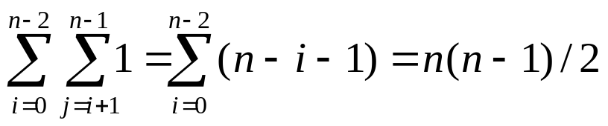

Example: selection sort
Assume n>=2
Choose “if (A[j]<minv)”
as the barometer. The number
of times the barometer is
executed is
Now the total execution
time is in Θ(n²)
int selectionSort(int A[], int n)
{
int i, j, minj, minv;
for (i=0; i<n-1; i++) {
minj=i; minv=A[i];
for (j=i+1;j<n;j++) {
if (A[j]<minv) {
minv = A[j];
minj = j;
}
}
A[minj] = A[i];
A[i] = minv;
}
}

